Slide 1
ATM banking management system

Slide 2
Agenda
INTRODUCTION
Project abstract
PURPOSE of project
Atm banking module
Starting page design
coding
CONCLUSION

Slide 3
introduction
The Automated Tailor Machine is an automatic banking machine which allow customer to complete basic transaction without any help of Bank representatives.
There are two types of ATM. The basic one allows the customer to allow cash and another one is more complex machine which accepts the deposit, provides credit card payment facilities, and reports account information.
My project is basic ATM banking system which draws only cash and receive a report of account balance.

Slide 4
Project Abstract
In banking system, different branches are present and these are connected to the main branch. So, the same bank is located at different locations for providing the same type of banking services.
The manual method of managing these banks from one location is difficult, but it can be easily done with an ATM software application like this.
The overall banking procedure has become much easier, comfortable and secured as well with ATM (Automated Teller Machine).
ATM has saved customers time for withdrawing balance, checking recent transactions and checking bank balance from any location.
With the proposed ATM Banking System, bank management is easier with a more efficient platform for managing customer details, managing their account and recording their transaction history.

Slide 5
Purpose of project
ATM Banking system is a software application developed in Asp.Net, Now ATM stands for automated teller machine it is widely used in all over the world to perform various Banking software various banking operation with this ATM banking software various task done by a typical bank management application can be done such as :
Adding Customer detailed
Viewing customer cash withdrawal/deposited details.
Managing banking account
Generating pin
Mini statement
Printing report and many more

Slide 6
Atm banking module
This project comes up with the source code for understanding the logical operations of every module incorporated into this system.
This application consists of various forms which are again divided into sub-forms based on their functions. The forms in ATM Banking System are:
Create admin account
Admin login/logout
Create customer
View customer
Add customer account details
View customer transaction details
Customer card number
Balance check
Customer receipt upon balance check and cash withdrawal

Slide 7
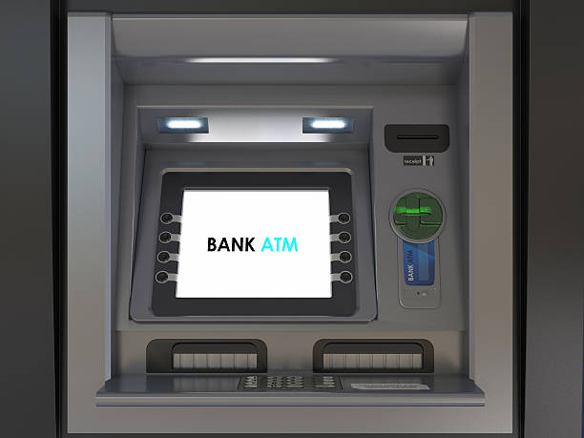
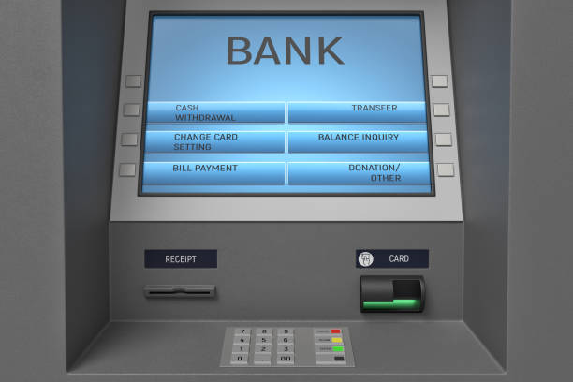
Starting page design

Slide 8
CODING
import java.util.Scanner;
class Bank{
// Private variables used inside class
private String name;
private int accNumber;
private String type;
private int amount = 0;
private int tot = 0;
// Public methods
public void setValues() {
Scanner scanner = new Scanner(System.in);
System.out.println("Enter name");
scanner.nextLine(); // To consume newline character
name = scanner.nextLine();
System.out.println("Enter Account number");
accNumber = scanner.nextInt();
System.out.println("Enter Account type");
type = scanner.next();
System.out.println("Enter Balance");
tot = scanner.nextInt();
}
public void showData() {
System.out.println("Name: " + name);
System.out.println("Account No: " + accNumber);
System.out.println("Account type: " + type);
System.out.println("Balance: " + tot);
}
public void deposit() {
Scanner scanner = new Scanner(System.in);
System.out.println("\nEnter amount to be Deposited");
amount = scanner.nextInt();
}
public void showBalance() {
tot += amount;
System.out.println("\nTotal balance is: " + tot);
}
public void withdrawal() {
Scanner scanner = new Scanner(System.in);
int a, availableBalance;
System.out.println("Enter amount to withdraw");
a = scanner.nextInt();
availableBalance = tot - a;
System.out.println("Available Balance is: " + availableBalance);
}
}
public class ATMManagementSystem {
public static void main(String[] args) {
// Object of class
Bank b = new Bank();
int choice;
// Infinite while loop to choose options everytime
while (true) {
System.out.println("\n~~~~~~~~~~~~~~~~~~~~~~~~~~" +
"~~~~~~~~~~~~~~~~~~~~~~~~~~~~" +
"~~~WELCOME~~~~~~~~~~~~~~~~~~" +
"~~~~~~~~~~~~~~~~~~~~~~~~~~~~" +
"~~~~~~~~~\n\n");
System.out.println("Enter Your Choice");
System.out.println("\t1. Enter name, Account number, Account type");
System.out.println("\t2. Balance Enquiry");
System.out.println("\t3. Deposit Money");
System.out.println("\t4. Show Total balance");
System.out.println("\t5. Withdraw Money");
System.out.println("\t6. Cancel");
Scanner scanner = new Scanner(System.in);
choice = scanner.nextInt();
// Choices to select from
switch (choice) {
case 1:
b.setValues();
break;
case 2:
b.showData();
break;
case 3:
b.deposit();
break;
case 4:
b.showBalance();
break;
case 5:
b.withdrawal();
break;
case 6:
System.exit(0);
break;
default:
System.out.println("\nInvalid choice");
}
System.out.println("Thank you for choosing atm service");
}
}
}

Slide 9
CONCLUSION
ATM Banking System can be used as your final year/semester project or mini/major project in ASP.NET.
This software development project will help you understand the design basics of banking operations and transactions such as creating customer accounts, managing accounts, checking balance, etc. Overall, it gives a complete overview of a typical banking software integrated with ATM.

Slide 10
Thank You

